Slide 1

Foundations of Entrepreneurship
Myths and Realities on Entrepreneurship
Lecture Note : 3 08.01.2021
Notes:
The fear of ghost: the phobia is unintentionally created by parents or seniors to dissuade children from doing something during their formative years. It gets ingrained in their personality and an inseparable part of life.
The same goes about the career options. We are repeatedly reminded to study well so that we manage to bag a government job. Obviously, we are not mentally aligned with entrepreneurship.

Slide 2
Concepts Covered:
Myths and assumptions about entrepreneurship.
Facts and realities.
How myths prevent people from creating their own venture.
How myths can misguide and lead to failure.
Notes:
Myth: a widely held but false belief or idea.

Slide 3
True or False?
People from business families are more likely to be successful entrepreneurs compared to others.
Hailing from a rich family ensure that you never run out of money and that is why most successful entrepreneurs have rich family background.
Failure should not deter you. Persistence is a great virtue. You should persist as long as you do not meet success.
Entrepreneurship qualities are innate and they are difficult to be learnt. Therefore, one can go so far in trying to learn entrepreneurship.
Extrovert people have better success rate in entrepreneurship.
Most people presume that entrepreneurs are well-respected. But why only a small percentage of the people attempt to create new ventures?

Slide 4
Myths are not frequently discussed but
they cause great concerns and harm.

Slide 5
E–Myth by Michael E Gerber
Three types of personalities
THE ENTREPRENEURIAL personality is the visionary, the innovator of new products, new processes, new markets and new business models. He preempts and is always evolving. He turns every condition into an opportunity. He disrupts status quo. He lives in the FUTURE.
THE MANAGER IS PRACTICAL. Without him, there is no planning and order. He needs order instead of control, consistently sees problems in events, and instinctively holds on to the status quo. The managerial personality lives in the PAST, and organizes and puts in order the things that the Entrepreneur creates.
THE TECHNICIAN BELIEVES that if you want something done right, you should do it yourself. For him, things are supposed to be done. He lives in the PRESENT.

Slide 6
Myths, Fantasies, Misconceptions and Realities
Looking at successful entrepreneurs one may not realize the years they spent striving for a foothold in their businesses.
Frequently, we believe that they are successful because luck favored them.
The real story may be very different. Obviously, the background remains invisible to all of us.
Misperceptions about what it takes to launch your own venture abound.
Notes:
Because of our ignorance about the years of striving for a foothold in their business, we tend to think that luck is all that is necessary to be successful entrepreneurs. Let us study the myriads of misconceptions about entrepreneurship and explore what the facts are.

Slide 7
Why Many of Us Do Not Start a New Venture? Why Many of Us Begin without Much Exploration?
“ALMOST 70% of the adult population across 52 major economies believes that entrepreneurs are well regarded and enjoy high status within their societies” – GLOBAL ENTREPRENEURSHIP MONITOR report 2017-18
We tend to believe that There’s a secret, “silver bullet” key to success.
Myths are the misconceptions that prevent people from dreaming big about entrepreneurship.
The flip side is that you will know your capabilities only when you begin.
Let us explore some of the myths.
Notes:
People in general regard entrepreneurs in high esteem. Still many do not consider taking up entrepreneurship. Some myths may be partly responsible.
In business, many successful entrepreneurs promote the impression that they’ve found some kind of secret key to success. However, this doesn’t take into account the entrepreneur’s previous ideas that failed; the old-fashioned hard work and patience they put in; or any of the many other factors that are necessary to build a strong company. The reality is that a single key to success does not exist. If anything, entrepreneurial success requires a keychain of different ideas, people, and resources that must come together at the right time and place. Finally, the other critical elements of success are the execution and the business process management.

Slide 8

1. Myth: Entrepreneurs are born, not made
“Entrepreneurship is a discipline that can be learned. Passion and persistence may be in your genes, but it takes work to develop the skills that entrepreneurs have.” - Peter Drucker
Majority of the successful entrepreneurs are first generation entrepreneurs.
In the book ‘Good to Great’, Jimm Collins has identified the top 11 companies who scaled their company to more than a billion dollar valuation, 10 have been promoted by fist-generation entrepreneurs.
Notes:
The word entrepreneurship is usually associated with first generation entrepreneurs.
I have a number of them, and I will take you through them quickly…

Slide 9
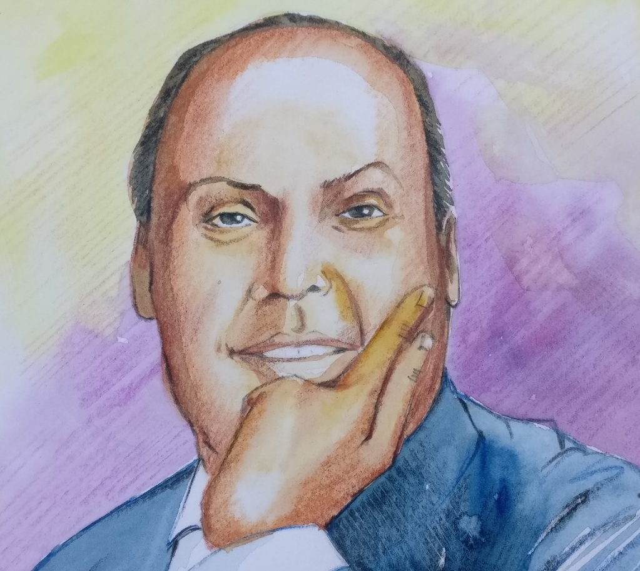
Dhirajlal (Dhirubhai) Hirachand Ambani (28 December 1932 – 06 July 2002)
A first-generation entrepreneur par excellence
Born in a poor family in a remote village in Gujarat.
Dropped out of school due to poverty.
Migrated to Aden looking for career and skills.
Went ahead to create some of the best industries of our country.
Created enormous wealth, jobs, and infrastructures for the nation.

Slide 10
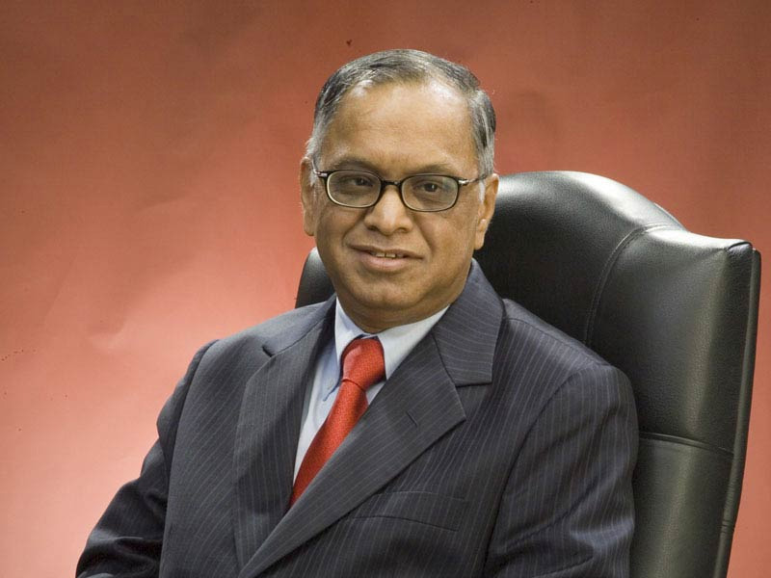
Narayana Murthy
Narayana Murthy co-founded Infosys in 1981, with a start-up capital of $250, which he borrowed from his wife Sudha Murthy.
Today, the market value of Infosys is more than three lakh crore Rupees.
Image source https://www.infosys.com/SiteCollectionImages/responsive/media/nrn.jpg

Slide 11
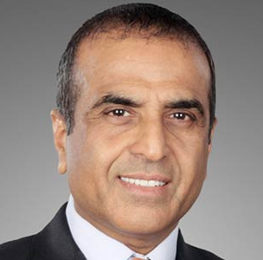
Sunil Bharti Mittal – A true first generation entrepreneur
Sunil Mittal borrowed ₹20,000/- from his father (erstwhile Rajya Sabha MP) to start his first venture for manufacturing components for a local bicycle company.
He went on starting one after another new businesses and never looked back. His present net worth is about $11 billion (as on 2020).
Image source https://indusbusinessjournal.com/wp-content/uploads/2017/04/Sunil-Bharti-Mittal-new.jpg

Slide 12
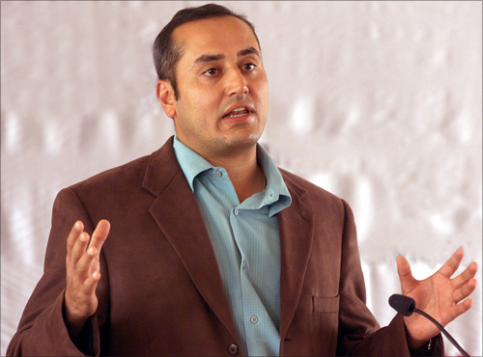
Sabir Bhatia
Adversity transformed into opportunity
Sabeer Bhatia - an inspiring entrepreneur, has risen from scratch and used his education to become one of the most successful Indian entrepreneurs.
Bhatia cofounded Hotmail.com with Jack Smith and later sold to Microsoft for $400 million.
Image source: http://im.rediff.com/money/2013/jan/21sabeer1.jpg

Slide 13
Dr. Govindappa Venkataswamy
Dr. Venkataswamy envisioned to eradicate needless blindness in India. Given the huge number of people needing eye surgery, Dr. Venkataswamy has emulated the service efficiency model of McDonald's fast food to treat millions of patients.
Invented business model that facilitate subsidization of the poor by the able, bringing quality and equity across people.
Aurolab, a company by Aravind, indigenously developed low-cost high quality intraocular lens implants that are exported to more than 160 countries.
Aravind has established and maintains four eye banks.
Notes:
He was a doctor with a difference. He envisioned to solve a problem that was bogging the whole society.

Slide 14

Oprah Winfrey
She is like a phoenix rising out of ashes.
An incredibly successful woman – the daughter of an unmarried teen who worked as a housemaid, Oprah grew up in abject poverty.
Her family was so poor that her school dresses were made of potato sacks.
She is an American media executive, actress, talk show host, television producer and philanthropist.
Her present net worth is about $ 3 billion.
Notes:
Finix.

Slide 15
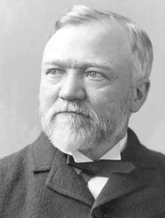
Andrew Carnegie
The early life of Carnegie was really rough.
He spent his childhood working in factories.
He used to starve and sleep to forget constant hunger.
However, Carnegie eventually worked his way up to create several businesses, most successful being the Carnegie Steel Mill.
He remains one of the richest Americans of all-time.
But, he is also one of the greatest philanthropists donating about $ 4 billion (in today’s value).
Notes:
A great philanthropist. He donated the lion’s share of his $ 300 billion dollar wealth to charity.

Slide 16
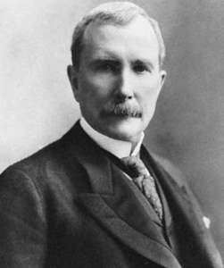
John D. Rockefeller
Rockefeller was the son of a traveling salesman.
He showed early entrepreneurial promise selling candy and doing odd jobs for neighbors
But went on to become one of the world's wealthiest individuals of all time.
He founded many companies, one of them being the Standard Oil Company. Would be valued $ 1 trillion today.
He was a major philanthropist.
His personal net worth would be $ 400 billion today.
Notes:
Net worth about $ 418 billion

Slide 17
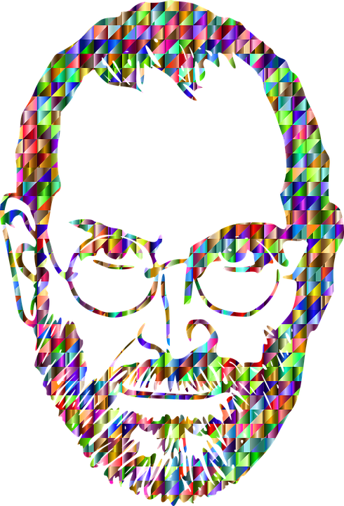
Steve Jobs
One can’t make a credible list of first-generation entrepreneurs without throwing in Steve Jobs.
Jobs dropped out of college as his family could not support the cost.
He unofficially continued to audit classes.
He lived off free meals from the local Hare Krishna temple and used to collect empty beverage cans to exchange for some change.
Jobs is widely recognized as a pioneering contributor to the microcomputer revolution of the 1970s and 1980s.
Today, Apple is valued more than $ 2,200 billion dollar.

Slide 18


Slide 19
2. Myth: Entrepreneurs Are High Risk Lovers
In reality, entrepreneurs have the capability and the gumption to visualize the way to alleviate the risks that others can't and convert the risky business proposition into an opportunity.
Entrepreneurs find opportunities in adversities. From outside, it may appear as if they are embracing undue risks. When they become successful, we give credit to luck for their success.
The hard fact is that attractiveness of an opportunity is correlated with the amount of risks. Else, opportunities would vanish should their be no risk.
If one has to target high growth, one has to embrace calculated risks.
Therefore, it is right that entrepreneurs are not averse to risk, but it is wrong to think that entrepreneurs love risk.

Slide 20
3. Myth: It takes a lot of money to start a business
Not true!
More than 80 percent of new ventures are bootstrapped from personal savings, credit cards, friends and relatives, and sweat equity. In fact, every year Inc magazine profiles businesses that have started on $1,000 or less.
In the annual list of the 5000 fastest-growing private companies, no relationship is observed with the initial investment capability.
The flip side: Some money at the beginning can accelerate the development process, reduce undue stress, and retain focus. Unless you have something to demonstrate the validity of the idea, very few would like to chip in money.
What is 'Sweat Equity'
Sweat equity is the non-monetary investment that owners or employees contribute to a business venture. Startups and entrepreneurs often use this form of capital to fund their businesses, by compensating their employees with stock rather than cash — which also helps to align risk and rewards.
Notes:
Sweat equity is the non-monetary investment that owners or employees contribute to a business venture. Startups and entrepreneurs often use this form of capital to fund their businesses, by compensating their employees with stock rather than cash — which also helps to align risk and rewards. – Investopedia.com

Slide 21
4. Myth: Entrepreneurs are in it for the Money
Most, if not all, startups take several years to turn a profit.
Those who create new ventures to make quick money frequently become frustrated with early failures and call it quit.
Those who are passionate about solving a pain in the society, sustain even at the face of failure and have the energy to fight back.
Most important reason for becoming entrepreneur is observed to be the desire to become independent and not get-rich-quick.

Slide 22
5. Myth: Entrepreneurs are born in business families!
Entrepreneurship is mostly associated with ‘First Generation Entrepreneurs’. They are the real wealth creators.
Access to large capital is a major advantage for those from established business families.
But this difference is gradually diminishing with transformation of ecosystem, growth of angel investors and venture capitalists.
The real differentiators are the entrepreneurial qualities, innovation contents, managerial capability, passion, and balanced skills of the team members.

Slide 23
Entrepreneurs Are Born in Business Families and those who are not … contd.
First generation entrepreneurs are likely to educate them better so they do not make common mistakes.
They may prepare themselves to be more resilient and ready to fail fast and pivot.
They are likely to be free of the traditional business philosophy baggage and equipped with modern management tools.
They develop superior value propositions to customers, maintain quality, maintain after-sale service, invest in creating trust, and build loyal customer base.
Notes:
First generation entrepreneurs are mindful of their limitations and they educate themselves better.

Slide 24
6. Myth: One has to be Young and Restless
As revealed in the Global Entrepreneurship Monitor report 2017-18, early stage entrepreneurship is almost evenly distributed among persons of age ranging from 18 to 64 years.
As such, one can become an entrepreneur at any stage of life.
Youth is characterized by high level of energy and remaining current with emerging technologies.
Managerial experience, networking, knowledge of business operation process may give advantages to matured person.
Notes:
Experience has some definitive advantages.

Slide 25
7. Myth: Entrepreneurs Give Little Attention to Their Personal Life
New businesses demand attention. So does established companies. Expert entrepreneurs are not different from executives in established companies on this issue.
The difference is that entrepreneurs do not mind working long hours, whereas, employees may have to attend emergency meeting during odd hours against their will.
Entrepreneurs tend to schedule important meetings during the week so that they can have weekends off for their personal life.
However, it is wrong to think that entrepreneur is the boss who sits back, while others do all the work and make him rich.

Slide 26
8. Myth: Most Entrepreneurial Ventures Fail
The reality is that collection of data are motivated by different objectives (Ref. Entrepreneurship by David H. Holt).
In particular, data collection process fails to recognize transformation of companies through merger, takeovers, incorporation into larger organization, and change of names to align with changing technological landscape.
Statistics in this regard can be misleading.
Fatality is prevalent even in large established businesses. The average life of Fortune 500 companies have come down to 15 year from 61 years (projected to be 12 years in 2027).
Notes:
May not be so jarring.

Slide 27
9. Myth: Entrepreneurs Are Often High-Tech Wizards
There definitely are high-tech entrepreneurial wizards who have created successful enterprise.
But there is no evidence of this to be a common phenomena.
Chances are that the successful ones have taken care of all other aspects of business operation management.

Slide 28
10. Myth: Entrepreneurs Are Loners. Only Extroverts Become Successful Entrepreneurs
Success in entrepreneurship very much depends on networking, and sharing ideas, experiences with others including employees to validate business ideas.
A loner can't be a successful entrepreneur.
In a comprehensive study of great ventures, Jim Collins in the book “Good to Great” says that majority of the CEOs of great companies are introvert.

Slide 29
11. Entrepreneurs Finance Their Business with Venture Capital
Two important points”
VCs have less risk appetite.
VC funds are costlier than other sources such as bootstrapping and angels.
Early ventures are perceived to be very risky.
As the ventures progresses on to the value chain, it gets its ideas validated by customers. They may even pivot several times over.
In the process they keep alleviating the risks.
Most entrepreneurs fund their businesses from personal savings, borrowing from friends, seed money, government grants, and fund from angels. Less than 1% of all new businesses are backed by VCs.

Slide 30
12. Myth: Entrepreneurs are Often Ruthless or Deceptive, Dishonest, Unscrupulous
Entrepreneurs need to spend maximum time addressing pressing needs of the business. The truly ruthless or deceptive entrepreneur will remain engaged in repairing relationships with employees, customers, and suppliers, or simply fail.
Competitors who resort to unfair means to gain advantages would eventually implode.
Notes:
deceitful, duplicitous, fraudulent, counterfeit, sham, bogus, cheating, underhand,cunning, crafty, sly, guileful, scheming, perfidious, treacherous, Machiavellian,dissembling, disingenuous, untrustworthy, unscrupulous, unprincipled, dishonest,untruthful, lying, mendacious, insincere, false;

Slide 31
13. You need a business plan to succeed
A business plan helps in planning in the long and short-term.
But a business plan does not guarantee success. Neither lack of a business plan dictates failure.
Getting the product or service validated by real customers early on is more important.
A well-laid out business plan is essential if you are approaching to investors.
Having an Operations Manual in place like the bedrock.
Notes:
What you actually need is a product that customers are delighted to repeatedly buy at a profitable price.

Slide 32
14. Most successful entrepreneurs start with a breakthrough invention, usually technological
Fact: Most successful entrepreneurs succeed by exceptional execution of ordinary ideas: See Google, Infosys and many others.
Majority of the successes is attributed to exceptional execution of existing ideas.

Slide 33
15. Myth: Being first to market is the key to success.
The first-mover advantage gained by being the first to market, establishing strong brand recognition and customer loyalty even before any competitor enters into the arena is generally recognized.
The first movers have advantages and disadvantages too.
Those who execute better than others in a way that delight the customers are the eventual winners.
There are many examples where first-mover advantage did not work.
Yahoo versus Google is a glaring example.
Read the article “The Half-Truth of First-Mover Advantage” at https://hbr.org/2005/04/the-half-truth-of-first-mover-advantage

Slide 34
16. You have to start a company to be an entrepreneur.
Fact: People with passion and entrepreneurial zeal and vision to solve a problem of the society can find many ways to plan.
Incubating the idea and creating a successful venture within an enterprise is also possible, which is known as corporate entrepreneurship
Buying an existing company.
Converting a non-profit are all the possibilities.

Slide 35
17. Entrepreneurs strike it rich or miserably fail in their first venture
The reality is that most entrepreneurs pivot several times before meeting success or calling it quit.

Slide 36
18. The Belief that Understanding the Technology or Product is the Same as Understanding how to Run a Business.
Michael E. Gerber, the author of the book E-Myth says – “Most small businesses in America fail because they are started by people who are struck by an Entrepreneurial Seizure. The majority of these persons are Technocrats who assume that understanding the technical aspect of a business is the same as understanding how to run a business.”
Technology provides competitive advantages, but it is just one part of the many important elements to successfully run a business.

Slide 37
Myth 18 … contd.
Many technocrats with product ideas tend to think that they can start a business as soon as they are ready with the products.
Many of them spend years to build the product only to realize that it does not make a good fit to the needs, aspiration, and likings of the customers.

Slide 38
19. Passion Leads to Success
Following your passion without an eye for product market fit and customers acceptance often lead to failure.
Solving a problem for which people are ready to pay for and being passionate about executing the idea in a competitive way is synergistic.

Slide 39
20. Entrepreneurship Cannot be Taught!
While analyzing the reasons for failure of majority of the failed entrepreneurial ventures it would be evident that many of the failures could be averted with some prior knowledge that can be learnt through education.
With some additional knowledge, many of the failed ventures would not have been created in the first place.
It is also important that some entrepreneurial qualities are innate.
Therefore, one should target to solve as difficult a problem as their capability or build a balanced team and empower them to manage the business.

Slide 40
21. You Must Wear All the Hats
It's true that during early stage, you may have to make all decisions and do most of the important works.
But smart entrepreneurs quickly learn to hire out for tasks outside their core talent area.
Operating as a one person show frequently leads to frustration and burnout.
You need a support network including professionals.
"Many hands make light work“ is a time tested adage.

Slide 41
22. Myth: College Dropouts Make Better Entrepreneurs.
Study by Vivek Wadhwa of the Washington Post shows that the greater the education of the founder, the lower the rate of business failure and the higher the business’s profits, sales and employment.
Surprisingly, attending an elite university doesn’t provide a significant advantage in entrepreneurship. What matters is that the entrepreneur gains a higher degree.
The likes of Mark Zuckerberg dropped out of Harvard to create some of the greatest companies. It can be said that college dropouts make great entrepreneurs.

Slide 42
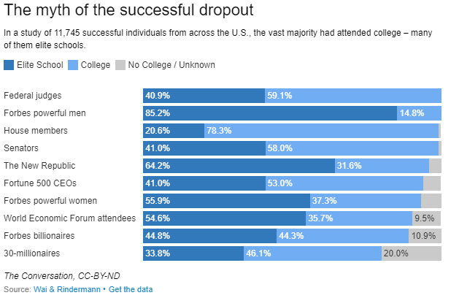

Slide 43
23. Myth: Women can’t cut it in the tech world
The Washington Post research found almost no difference in the factors driving success for male and female company founders.
Women and men have the same motivations, are of the same age, have same levels of experience and both equally enjoy the culture of start-ups.
Men and women are equally likely to have children at home when they start their businesses. (But men were more likely to be married.)

Slide 44
24. One Can Attain Success through Persistence
Persistence is a great virtue for startup success.
But one should not be blinded by this thought and persist beyond the moment it is time to pivot.
If failure is the destiny of an idea, the earlier it fails the better. Persisting with such an idea is like flogging dead horse.

Slide 45
Fake it Until You Make it
Theranos
Absolute power corrupts absolutely .

Slide 46
Michael E. Gerber of the book: E-Myth
Finally, understand that everything in your business is part of a system.
It is either a Hard System, Soft System, or Information System.
Everything that happens in one system affects everything else.

Slide 47
Some final words
It is important to note that majority of the entrepreneurial ventures fail due to reasons that could have been avoided with some prior knowledge and actions.
For example: Experts are of the opinion that if Sophia Amoruso had hired professional CEO at the cusp of the growth phase, NastyGal would not meet the fate it did.
Knowing the story alone is not good enough to make judgment.

Slide 48
https://medium.com/@KeithKrach/10-of-the-most-common-entrepreneurship-myths-e241e51e9e2f
Entrepreneurship: New Venture Creation by David H Holt, 4th Edition 2018, Pearson
Entrepreneurship Simplified by Ashok Soota and S R Gopalan, 2016, Penguin Random House
Various web resources
Various Wikipedia pages
Zero to One – by Peter Thiel and Blake Masters, 2014, Penguin Random House - UK
https://www.washingtonpost.com/opinions/five-myths-about-entrepreneurs

Slide 49
Concluding remarks
Majority of the successful entrepreneurs are the first-generation founders.
Family business tradition, wealthy background, and education may not guarantee success.
Whereas, successful entrepreneurs share some common traits that can be learnt.
Anyone can dream big and can be successful if they have a comprehensive plan of execution of an idea that solves an unmet pain of a large number of people.
Myths, fantasies, and misconceptions are impediments to dream something big.

Slide 50
Thank you

